Slide 1
CS 494/493 — COURSE PROJECT · SPRING 2026
PageHarvester
A polite, topic-targeted web crawler
GROUP 7
Team Members [ Kevon Mair, Nikhil Patel, O’Donovan Murphy, Omar Mountassir ]
Presenter(s) [ Omar Mountassir]
Presentation Day [ May 2nd 20206]

Slide 2
PAGEHARVESTER · GROUP 7
Outline
01
Team & tasks
06
Crawler traps
Roles and responsibilities
Identification & avoidance
02
Crawling purpose
07
Politeness
What PageHarvester does
Respectful crawling design
03
Tech stack & how to run
08
Efficiency
Python, libraries, setup
Fast, focused fetching
04
Crawler basics
09
Business & security needs
Seeds, agent, cadence, components
Stakeholders, requirements
05
Component descriptions
10
Architecture & threat model
Crawler & Logger internals
Design + risk surface
CS 494/493
2 / 14

Slide 3
PAGEHARVESTER · GROUP 7
Team Members & Tasks
Roles distributed across crawler design, security analysis, and documentation.
Member | Primary Responsibilities | Deliverables
[Murphy ] | Crawler core: robots.txt parsing, sitemap retrieval, page download logic | main.py — Crawler class, request handling
[Murphy/Patel ] | Logging, file I/O, output directory layout, error handling | Logger class, log.txt, output structure
[ Patel /Mair] | Attack-surface & threat-model analysis, stakeholder mapping | Attack Surface doc, power-interest grid
[ Mountassir/Mair/Patel] | Testing, demo target selection, presentation slides | Demo run on guardian.com, this deck
CS 494/493
3 / 14

Slide 4
PAGEHARVESTER · GROUP 7
Crawling Purpose
PageHarvester autonomously parses a target site's robots.txt and downloads HTML pages that match a user-chosen search topic.
DEMO RUN
theguardian.com
topic = "ukraine"
WHAT IT DOES IN PRACTICE
6
Reads robots.txt at a user-supplied URL
Extracts the listed sitemap XML files
Filters sitemaps that contain a topic keyword ("sentinel")
Pulls <loc> URLs and verifies each against robots.txt rules
Downloads only allowed pages, writing HTML to disk
Logs every action with timestamps
matching
HTML pages
saved
2
5s
100%
sitemaps
matched
request
delay
robots.txt
compliance
CS 494/493
4 / 14

Slide 5
PAGEHARVESTER · GROUP 7
Tech Stack & How to Run
LANGUAGE
LIBRARIES
EXECUTION
Python 3
Standard + requests
One command
Implemented in pure Python 3.
No compiled extensions, no framework lock-in. Runs on any OS with a Python 3 interpreter.
requests — HTTP fetching
urllib.robotparser — robots.txt
re — regex topic matching
pathlib, datetime, time, os, sys
1. pip install requests
2. python main.py
3. Enter robots.txt URL
4. Enter search topic (or blank for all)
OUTPUT LAYOUT
log.txt · session log · /_pages/<topic>/*.xml · matched sitemaps · /_pages/<topic>/*.html · downloaded pages
CS 494/493
5 / 14

Slide 6
PAGEHARVESTER · GROUP 7
Crawler Basics
NAME
INITIAL SEED
USER-AGENT
PageHarvester
robots.txt URL
* (configurable)
Group 7's crawler
User-supplied. Demo: guardian.com/robots.txt
Default wildcard; can be set to identify the crawler
CRAWL DELAY
TERMINATION
SCOPE
5 seconds
Sitemap-bounded
Topic-filtered
time.sleep(self.haltTime) between every request
Stops after all matching sitemap URLs are processed
Only URLs matching the user's search keyword
MAIN COMPONENTS
Logger
Crawler.parse_robots_txt
Crawler.storeSitemaps
Crawler.downloadPages
CS 494/493
6 / 14

Slide 7
PAGEHARVESTER · GROUP 7
Component Descriptions
Logger
log_entry (self, entry)
Opens log.txt at session start, writes a header timestamp, and exposes log_entry() for timestamped event lines used throughout the crawler.
Crawler
parse_robots_txt(self, logger)
Validates the user-supplied URL ends in /robots.txt, fetches it, parses with urllib.robotparser.RobotFileParser, and prompts the user for a search keyword (sentinel).
Crawler
storeSitemaps(sentinel, logger)
Pulls sitemap URLs from the parsed robots.txt. If a sentinel is found, downloads only sitemaps whose XML or URL contain the term; otherwise downloads every allowed sitemap.
Crawler
downloadPages(sitemap, sentinel, logger)
Reads the stored sitemap, regex-extracts <loc> URLs, calls RobotFileParser.can_fetch on each, and saves allowed pages as HTML — sleeping 5 s between requests.
CS 494/493
7 / 14

Slide 8
PAGEHARVESTER · GROUP 7
Designing a Polite, Robust, Benign Crawler
Politeness items implemented in PageHarvester:
1
Fixed inter-request delay
5 s sleep between every HTTP call to a target host.
FROM main.py
2
Robots.txt as the source of truth
Politeness in code
Every URL is gated by RobotFileParser.can_fetch() before fetching.
3
Sequential, single-threaded I/O
self.haltTime = 5
for cleanUrl in cleanUrls:
if self.RobotsParser.can_fetch(
self.userAgent, cleanUrl):
self.req = requests.get(cleanUrl)
time.sleep(self.haltTime)
if self.req.ok:
logger.log_entry(
f"Good REQ. Saving {cleanUrl}")
# write HTML to disk
No parallel request fan-out — at most one in-flight request at a time.
4
Targeted scope only
Only sitemap URLs that match the user's topic are touched.
5
No retry storms
A failed request is logged once and skipped; no exponential backoff loop.
6
Identifiable user-agent
userAgent attribute on Crawler — set once during construction, used end-to-end.
7
Full audit trail
Every parse, sitemap, fetch, and skip is timestamped in log.txt.
CS 494/493
9 / 14

Slide 9
PAGEHARVESTER · GROUP 7
Implementing an Efficient Crawler
Efficiency items in PageHarvester — cutting wasted requests, parses, and disk operations.
01
02
03
Sitemap-first discovery
Topic filtering at sitemap level
Word-boundary regex matching
Eliminates the need to search through “unallowed” HTML parent files.
Regex used against raw sitemap XML to return relevant URLS, before fetching any page data. Rejecting numerous URLs prior to download.
\bukraine\b avoids false positives like "ukrainian" or partial substring noise — fewer wasted page downloads.
04
05
06
Persisted XML cache
Streamed file writes
Single-purpose pipeline
Sitemaps are written to /_pages/<topic>/.
Open / write / close per file; HTML never accumulates in memory across the run.
parse → store → download. Each stage is independent and re-runnable on its own outputs.
CS 494/493
10 / 14

Slide 10
PAGEHARVESTER · GROUP 7
Q4 — Business & Security Needs
STAKEHOLDER POWER–INTEREST GRID
C
A
FUNCTIONAL REQUIREMENTS
Functional
Professor (Dr. Zabihi)
Parse robots.txt and extract sitemap URLs
Filter sitemaps and pages by user keyword
Download allowed pages to disk; log every action
Developers (us)
NON-FUNCTIONAL REQUIREMENTS
POWER →
Non-Functional
D
B
Politeness: ≥ 5 s between requests
Reliability: log file persists after crashes
Portability: runs on any Python 3 host
Website admins
SECURITY REQUIREMENTS
System admins
Security
Honor robots.txt — no fetch without can_fetch()
All actions auditable via timestamped log.txt
INTEREST →
A · Manage closely B · Keep satisfied C · Keep informed D · Monitor
CS 494/493
11 / 14

Slide 11
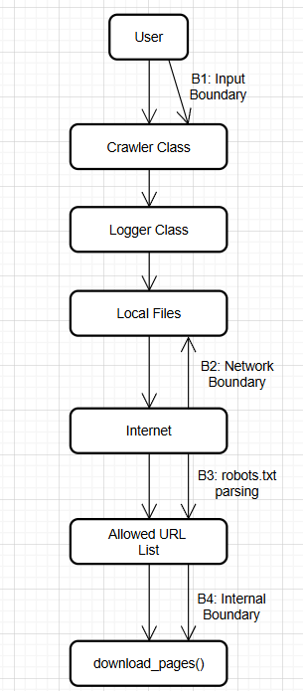
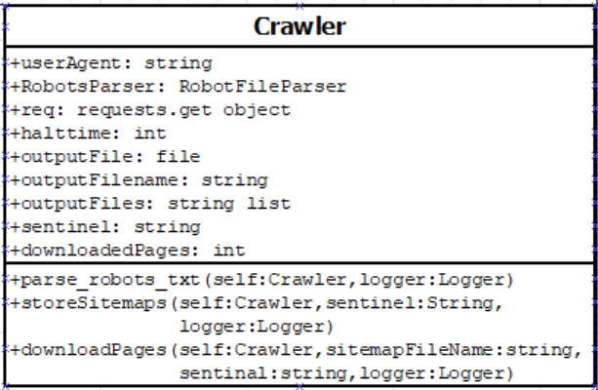
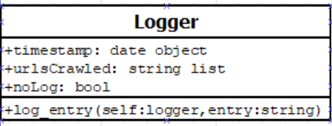
PAGEHARVESTER · GROUP 7
Q5 — Architecture & Threat Model
ARCHITECTURE
Two classes. Procedural approach — Crawler does the work, Logger records it. No persistent state between runs except log.txt and downloaded artifacts on disk.
TRUST BOUNDARY
UML DIAGRAMS
TOP THREATS · ATTACK SURFACE ANALYSIS
Vector | Impact | Sev
Outbound fetches to untrusted hosts | Direct exposure to attacker-controlled servers | 5
Unvetted 3rd-party libraries | Possible upstream vulnerabilities reach end user | 5
Malicious / oversized robots.txt | Excess memory & CPU during parsing | 3
Stored HTML may include protected data | Privacy or compliance exposure | 2
Target IP-blocking / CAPTCHAs | Crawler blacklisted from sites | 2
CS 494/493
12 / 14

Slide 12
PAGEHARVESTER · GROUP 7
Demo — Live Run Output
Run executed 2026-04-26 against guardian.com/robots.txt with topic = "ukraine".
RESULTS
log.txt
1
robots.txt parsed
Session Init: 2026-04-26
2026-04-26 Parsed Robots.txt!
2026-04-26 Found \bukraine\b in www.theguardian.com/sitemaps/news.xml
2026-04-26 Found \bukraine\b in www.theguardian.com/sitemaps/video.xml
2026-04-26 Good REQ. Saving page .../zelenskyy-signs-agreement-with-azerbaijan
2026-04-26 Good REQ. Saving page .../russian-airstrikes-ukraine-dnipro-odesa
2026-04-26 Good REQ. Saving page .../deadly-russian-strikes-dnipro-ukraine-video
2026-04-26 Good REQ. Saving page .../raf-typhoons-russia-drone-nato-romania
2026-04-26 Good REQ. Saving page .../chornobyl-power-plant-at-risk
2026-04-26 Good REQ. Saving page .../zelenskyy-holds-talks-azerbaijan-saudi
2
matching sitemaps stored
6
HTML pages downloaded
0
robots.txt violations
CS 494/493
13 / 14

Slide 13
PAGEHARVESTER · GROUP 7
Thank you.
Questions?
Source code, log, and attack-surface analysis available in the project repository: https://github.com/ODonovanMurphyII/CS493_Course_Project/tree/presentation_branch

